Slide 1
introduction to beemac inc

Slide 2
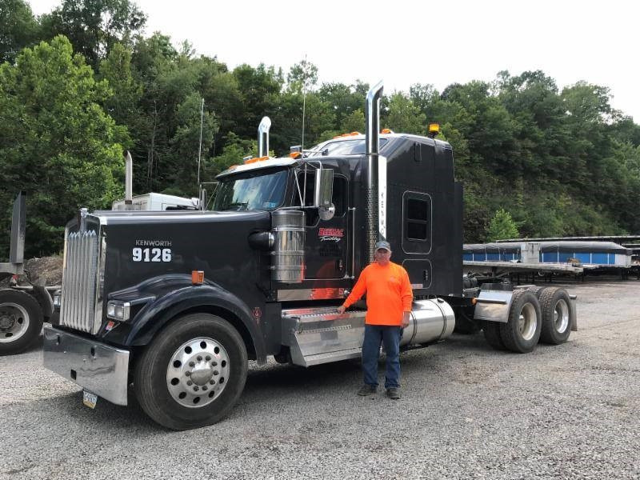
100% employee owned
BEEMAC INC.
who we are
Founded in 1984, Beemac began as a small privately held flatbed trucking provider based in Ambridge, PA.
Beemac has since grown to become the largest asset-based industrial focused full-service logistics provider in North America, generating over 460MM in revenue in 2022.
We offer asset-based trucking, logistics services, LTL solutions, intermodal shipping, transloading services, material management and specialized hauling services to customers throughout North America.
In 2019, Beemac became a 100% employee-owned organization. At Beemac, we pride ourselves on unmatched service and the quality of our employees. At Beemac Logistics, we truly believe that Relationships Move Loads.

Slide 3
BEEMAC INC.
mission statement
Our mission is to provide the highest quality professional trucking, logistics and intermodal services to our customers in the most safe and efficient manner possible. Our commitment to safety and personal service will be accomplished by effectively combining and managing our key resources, First Class professional drivers, innovative personnel, and the latest technology available.
We strive to achieve extraordinary levels of client satisfaction by employing highly qualified individuals and providing them with a challenging and rewarding work environment responsive to their needs for balance between their professional and personal lives.

Slide 4
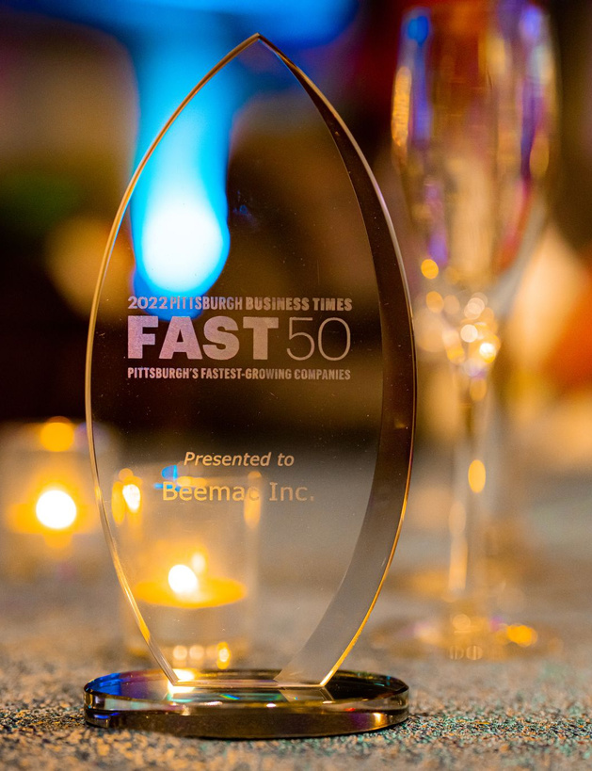
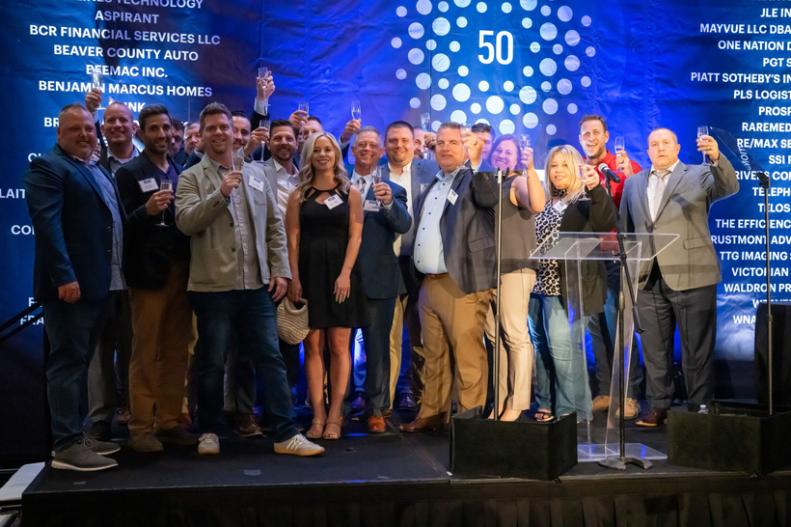
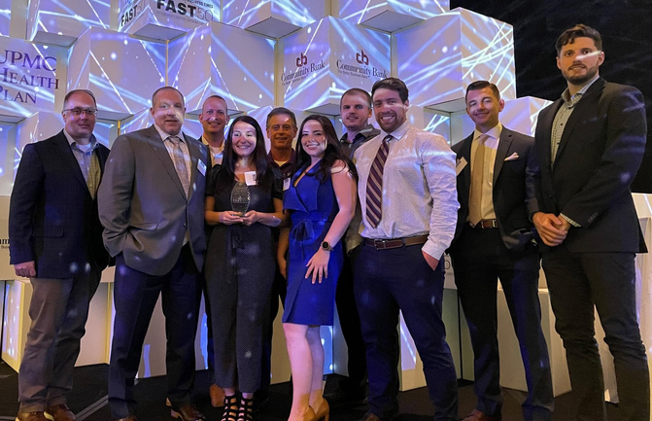
BEEMAC INC.
achievements & awards
2023 & 2022 Accomplishments:
Top 500 Largest For-Hire Carriers by Freight Waves 2023.
Ranked 60th Top Freight Brokerage Firms in the U.S. by Transport Topics 2023.
Ranked in the "Top 10" Flatbed/Heavy Specialized Carrier in the U.S. by Transport Topics 2023.
Named in the 2023 Pittsburgh Business Times “Fast 50.”
Named a winner of the Pittsburgh Post-Gazette’s “Top Workplaces 2022” Award.
Ranked No. 2552 on the Inc. 5000 list 2022.

Slide 5
BEEMAC INC.
relief swarm
We focus on emergency relief response and community initiatives at all times.
We work with many local and national charities, including:
Habitat for Humanity
Beaver County Humane Society
Women’s Center of Beaver County
12 Loaves Soup Kitchen
Families Matters Food Pantry
Produce to People
And more.

Slide 6
BEEMAC INC.
beemac trucking
TOP 20 LARGEST FLATBED/HEAVY HAUL CARRIERS IN THE USA (RANKED BY TRANSPORT TOPICS MAGAZINE 2022
HEADQUARTED IN AMBRIDGE, PA
32 TERMINALS ACROSS THE US/NATIONWIDE SERVICE
550+ TRUCKS/800+ FLATBED TRAILERS
STEP-DECKS, DOUBLE DROPS, STRETCH, RGNS, DRY VANS, HOT-SHOTS AND PNEUMATICS
OVER DIMENSIONAL/HEAVY HAUL DIVISION WITH DEEP EXPERTISE/IN-HOUSE PERMITTING, ROUTING, ESCORT SERVICES

Slide 7
BEEMAC INC.
DRIVER SAFETY CULTURE
POLICIES ABOVE AND BEYOND FEDERAL REQUIREMENTS
RANDOM DRUG AND ALCOHOL TESTING
SAFETY CLASSES AND CONTINUOUS TRAINING
FEDERAL/LOCAL REGULATION UPDATES
ALL BEEMAC YARDS CONDUCT DAILY SAFETY CHECKS
SATISFACTORY DOT RATING SINCE FOUNDING
OVER THE ROAD SAFETY VEHICLE FLEET CONDUCTS RANDOM EQUIPMENT AND LOAD SECUREMENT INSPECTIONS
BEEMAC SAEFTY DIRECTOR AVAILABLE TO WORK WITH CUSTOMER SAFETY DEPARTMENT
REPORT AND INVESTIGATE CARGO CLAIMS (IMMEDIATE RESOLUTION)

Slide 8
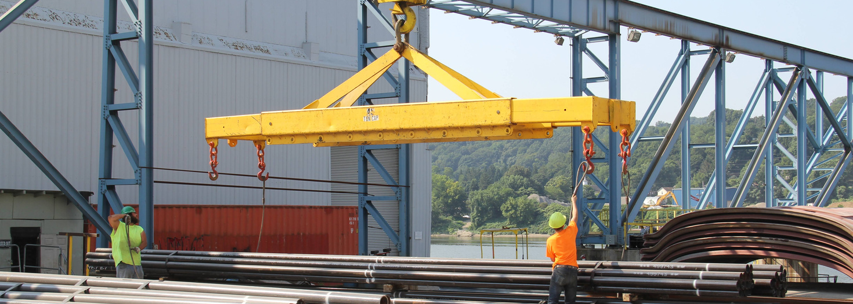
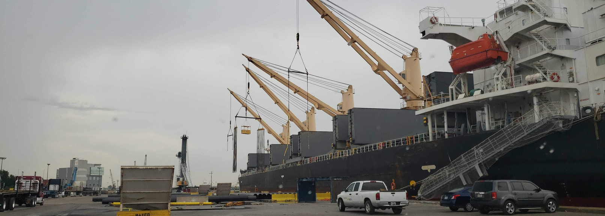
BEEMAC INC.
port services
PORT OF BEEMAC - LEETSDALE
45 TON OVERHEAD CRANE
BARGE AND RAIL CAR TRANS-LOADING
RAIL SERVICES WITH NORFOLK SOUTHERN AND CSX
5 FULLY MANAGED STORAGE FACILITIES / PIPEYARDS
INSPECTION SERVICES
LEETSDALE, PA / AMBRIDGE, PA / HOUSTON, TX / MIDDLETOWN, OH
INDOOR WAREHOUSE STORAGE
INVENTORY MANAGEMENT
CRANE AND RIGGING SERVICES
75 ACRES OF BEEMAC STORAGE SPACE UNDER MANAGEMENT
DIRECT DISCHARGE SERVICES / PORT OF HOUSTON
MATERIAL MANAGEMENT / MOBILE FORKLIFT SERVICES

Slide 9
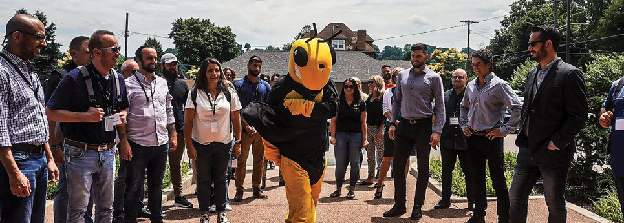
BEEMAC INC.
BEEMAC
LOGISTICS
35+ YEARS OF INDUSTRIAL LOGISTICS EXPERIENCE, BORN OF AN ASSET-BASED STEEL HAULER
THE MOST COMPREHENSIVE ASSET-BASED INDUSTRIAL-FOCUSED LOGISTICS NETWORK IN NORTH AMERICA, SERVING ALL MODELS OF TRANSPORTATION
FULL-SERVICE LOGISTICS OFFERING
ON DEMAND CAPACITY ACROSS ALL MODES, MANAGED SERVICES AND 3 PL SOLUTIONS
COST EFFECTIVE BROKERAGE SOLUTIONS
CUSTOMIZED INBOUND MANAGEMENT / MRO PROGRAMS
22,000 CONTRACT CARRIERS
LOGISTICS ENGINEERING AND SUPPLY CHAIN SONSULTING SERVICES
SHIPPING THOUSANDS OF FLATBED LOADS PER WEEK ACROSS NORTH AMERICA
60TH LARGEST FREIGHT BROKERAGE IN THE US RANKED BY TRANSPORT TOPICS 2023
JOINT VENTURE WITH MERCURY LOGISTICS / MUTUAL OWNERSHIP OF MERCURY TRANSPORTATION
BEST IN CLASS TECHNOLOGY AND VISIBILITY TOOLS
INDUSTRY TRAINED EXPERTS WITH DEEP ROOTS IN OIL AND GAS LOGISTICS

Slide 10
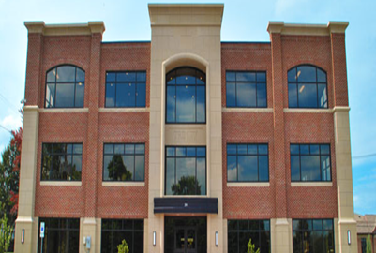
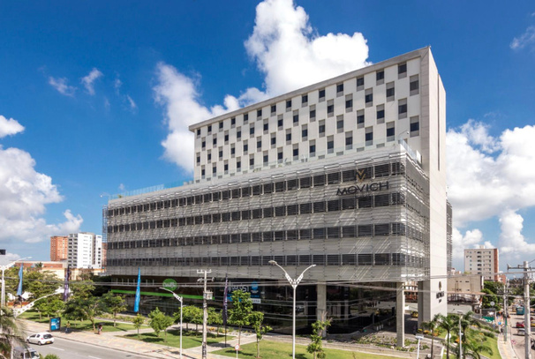
BEEMAC INC.
our offices
BEAVER, PENNSYLVANIA
295 3RD STREET, BEAVER, PA 15009
ESTABLISHED: 2016
BEEMAC LOGISTICS HEADQUARTERS
PITTSBURGH, PENNSYLVANIA
503 MARTINDALE STREET, PITTSBURGH PA15212
Established: 2018
HOUSTON, TEXAS
10350 RICHMOND AVE, HOUSTON, TX 77042
Established: 2019
ST. PETERSBURG, FL
200 CENTRAL AVENUE, ST. PETERSBURG FL 33701
Established: 2022
BARRANQUILLA, COLOMBIA

Slide 11
BEEMAC INC.
beemac / mercury partnership

Slide 12
BEEMAC INC.
business intelligence, reporting & visibility

Slide 13
BEEMAC INC.
ltl solutions
LTL SHIPPING
TIER 1 RATES WITH TOP 120 LTL CARRIERS
BEST-IN-CLASS CARRIER NETWORK
24/7/365 COVERAGE
MARKET-LEADING TECHNOLOGY
EXPEDITE SHIPMENTS
READY FOR ANYTHING. COUNT ON BEEMAC LOGISTICS TO TAKE TIME-CRITICAL SHIPMENTS WHEN IT MATTERS MOST.

Slide 14
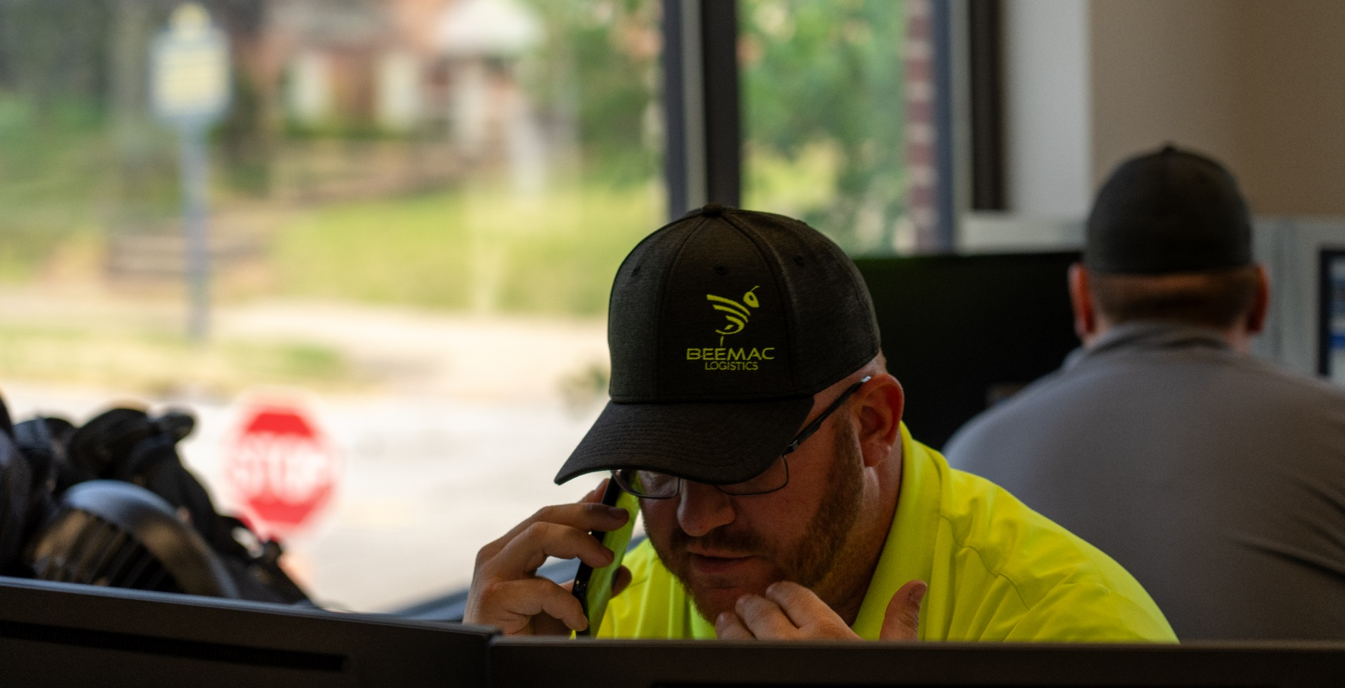
BEEMAC INC.
WHY CHOOSE US
ASSET-BASED, FINANCIALLY SOLID
RESPONSIBLE CORPORATE CITIZEN WHO GIVES BACK
TEAM PLAYER / ENTREPRENEURIAL SPIRIT
BUILDING STRONG CUSTOMER PARTNERSHIPS / UNDERSTANDING CUSTOMER NEEDS
DIVERSIFIED, MULTI-MODAL TRANSPORTATION PROVIDER
STRONG TRACK RECORD WITH MAJOR CUSTOMERS
TRUE VALUE-ADDED SERVICES
COST CONTAINMENT
NETWORK OF OFFICES NATIONWIDE

Slide 15
THANK YOU

